Slide 1
Introduction to group work
Conference
Rising up the Professional Competence by Contineous training
Monday 5. September 2016

Slide 2
Practice Theory Models
Assumptions of three dimensions
Human Behavior
Assumptions and research about risk and resilience factors that affect human development and behavior
Change Process
Theories about how people change their thoughts, feelings, and behaviors in different situations
Interventions
Skills
Techniques
Strategies
Used in practitioner-citizen interactions
Why do people behave as they do? What role does the environment play?
How do people change? What activates or motivates the process?
What activities can improve citizen adaptation or well-being?

Slide 3
Recovery & Living Well Increased self efficacy…
Empowerment
Increased Sense of Self-Efficacy
“Increased self-efficacy allows citizens to view disease, stress and symptoms differently, giving more opportunities for effective self-management”
Enhanced Self-Management Skills

Slide 4
Issues to diskuss
How can you continue to develop the National Centre of competence and what will the education programme look like going forward?

Slide 5
Autonomy & Competence
What Social-Worker Should Do and Not Do
Do More of These
Support citizen to explore resistances and barriers
Give feedback
Compliment mastery, skill
Provide respectful, caring encounters
Do Less of These
Suggesting incentives
Motivating through authority
Showing disapproval
Over-challenging the citizen beyond current capacity
The citizen/social worker partnership is an important medium and vehicle for change.

Slide 6
Recovery and rehabilitation How we understand the terms
Citizen Perspective
Recovery is a citizen perspective which means hope for the citizen.
The citizen will recover, and get a good life
Professionally rehabilitation perspective
Rehabilitation is the action professionals should offer to support the citizen to recover
Notes:
A professional can not recover a citizen
A professional can offer rehabilitative interventions aimed at promoting citizen's recovery process

Slide 7
Recovery process
Stabilization
Stabilization of the mental illness through the treatment
Recognition of the condition and psychological stabilization
Reorienting
Grief of loss
Struggle to find new meaning in life
Find hope
Reintegration
The person begins to reclaim his life

Slide 8
Recovery 4 basic values
Self-determination
Person-oriented
Personal Involvement
Hope
Based on the Disability Convention description of the rights of citizens

Slide 9
Rehabilitation
Rehabilitation is a goal-oriented and time-bound process of cooperation between citizens, relatives and professionals
The aim is that the citizen who has or is in risk to diminished physical mental and / or social functional ability, can achieve independence and a meaningful life.
Rehabilitation is based on the citizen's whole life situation and decisions, and consists of a coordinated and coherent knowledge-based efforts.

Slide 10
Empowerment
A perspective in social and health care work
A mindset
An approach
A strategy that is based on citizen perspectives
Methodical principles
Demands to the professionals

Slide 11
Empowerment
a process in which the power being developed, facilitated or confirmed with the aim of disadvantaged individuals and groups:
can increase their resources Strength their self-image Develop ability to act on its own behalf in the psychological, socio-cultural, political and economic areas

Slide 12
Empowerment means
A critical look / potential that can strengthen a user approach - especially in relation to the work with vulnerable groups.
Empowerment can challenge the traditional exercise of power in social and health care work
Empowerment offers A three-pronged approach that can mitigating their consequences: Fokus the individual - self-esteem and action Fokus in social contexts - groups, families and contexts Fokus at community, organization or network.

Slide 13
Handling the profession's role
Everyone should be aware of the scope of work: purpose, participants, meeting management, duration, summary, the next meeting, routes, etc. All must have access to the same information and the same preparation. Knowledge must be shared - play with open cards. Tidily and clear definition of the situation, roles and expectations Authentic communication and interaction  Openness on assumptions and performances

Slide 14
Contact is essential
Tuning in simple questions wonder and be curious Respons on statements, body language and ambiguity - "acknowledgment of receipt" Let the citizens themselves summarize the meeting's outcome.
Communicative handle Ask what changes users want. Respect their wishes and offer your partnership - even when they do not want change had attention to details that are important for the users find out from together with the users, what the next step is work with user goals - bank on to their dreams ask simple questions - do not assume or presume Give power from you - do not hold back information

Slide 15
The difficult
To do away with traditional understandings of: Professionalitet Caring Power to define partly by profession role partly through institutional set of possibilities Denied individual freedom in the work. Not everything is equally good, which commits to relate explicitly to his own and others' work
The power to name - the power to act Empowerment can offer a meaningful optics activity as care paradigm Empowerment can be used as active retaining the professional help as facilitative Empowerment strengthen professional awareness and handling of users' right to define the problem and action

Slide 16
USER PARTICIPATION
New legislation in 1998 which provides for users participation and influence in decision-making around specific services, principal organisation and utilization of services
Three levels of user involvement
The individual level
The collective, local level
The collective and centralized level
All regulated in the legislation.

Slide 17

Different ways and models to work with partipation
Trafiklight – who decides?
Red = Influence
Yellow = Involvement
Green = Selfdetermination
Notes:
The first day is tough, because here is an introduction of three words / concepts (the other days there is just one word). These three words are the main concepts during the whole course and are used again and again. The coceprts are illustrate by coulours

Slide 18
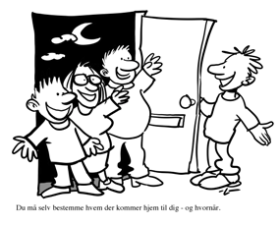
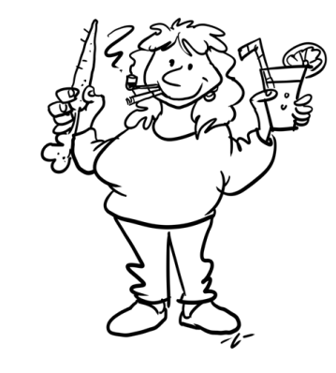

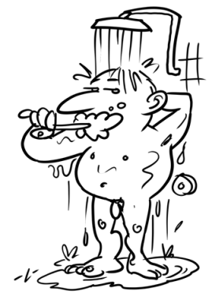
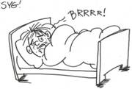
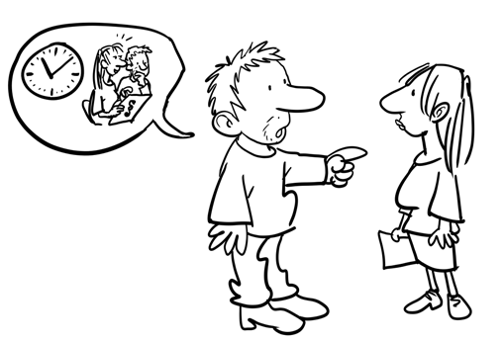
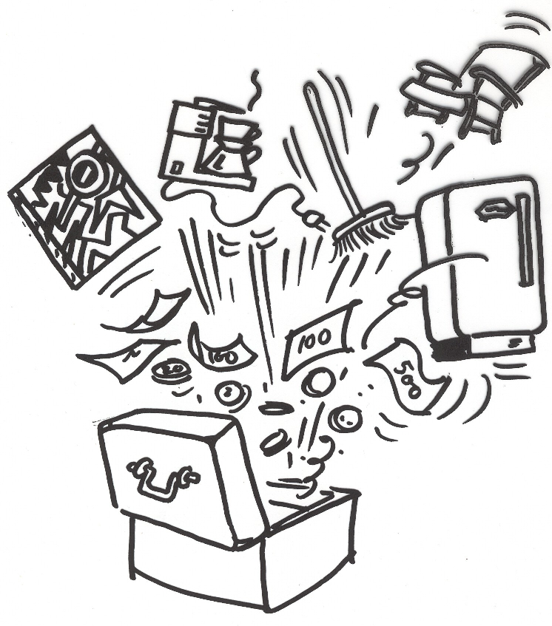
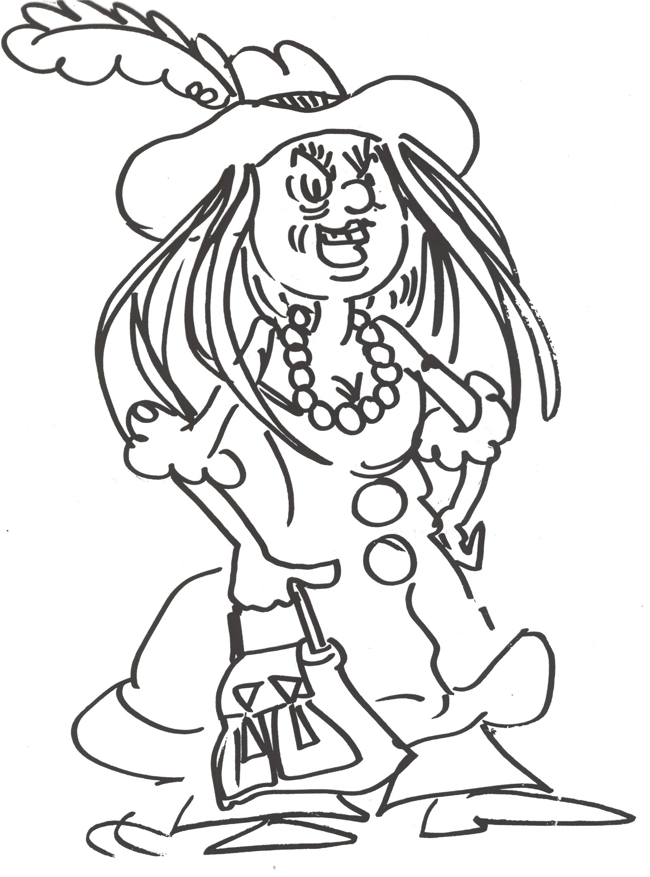
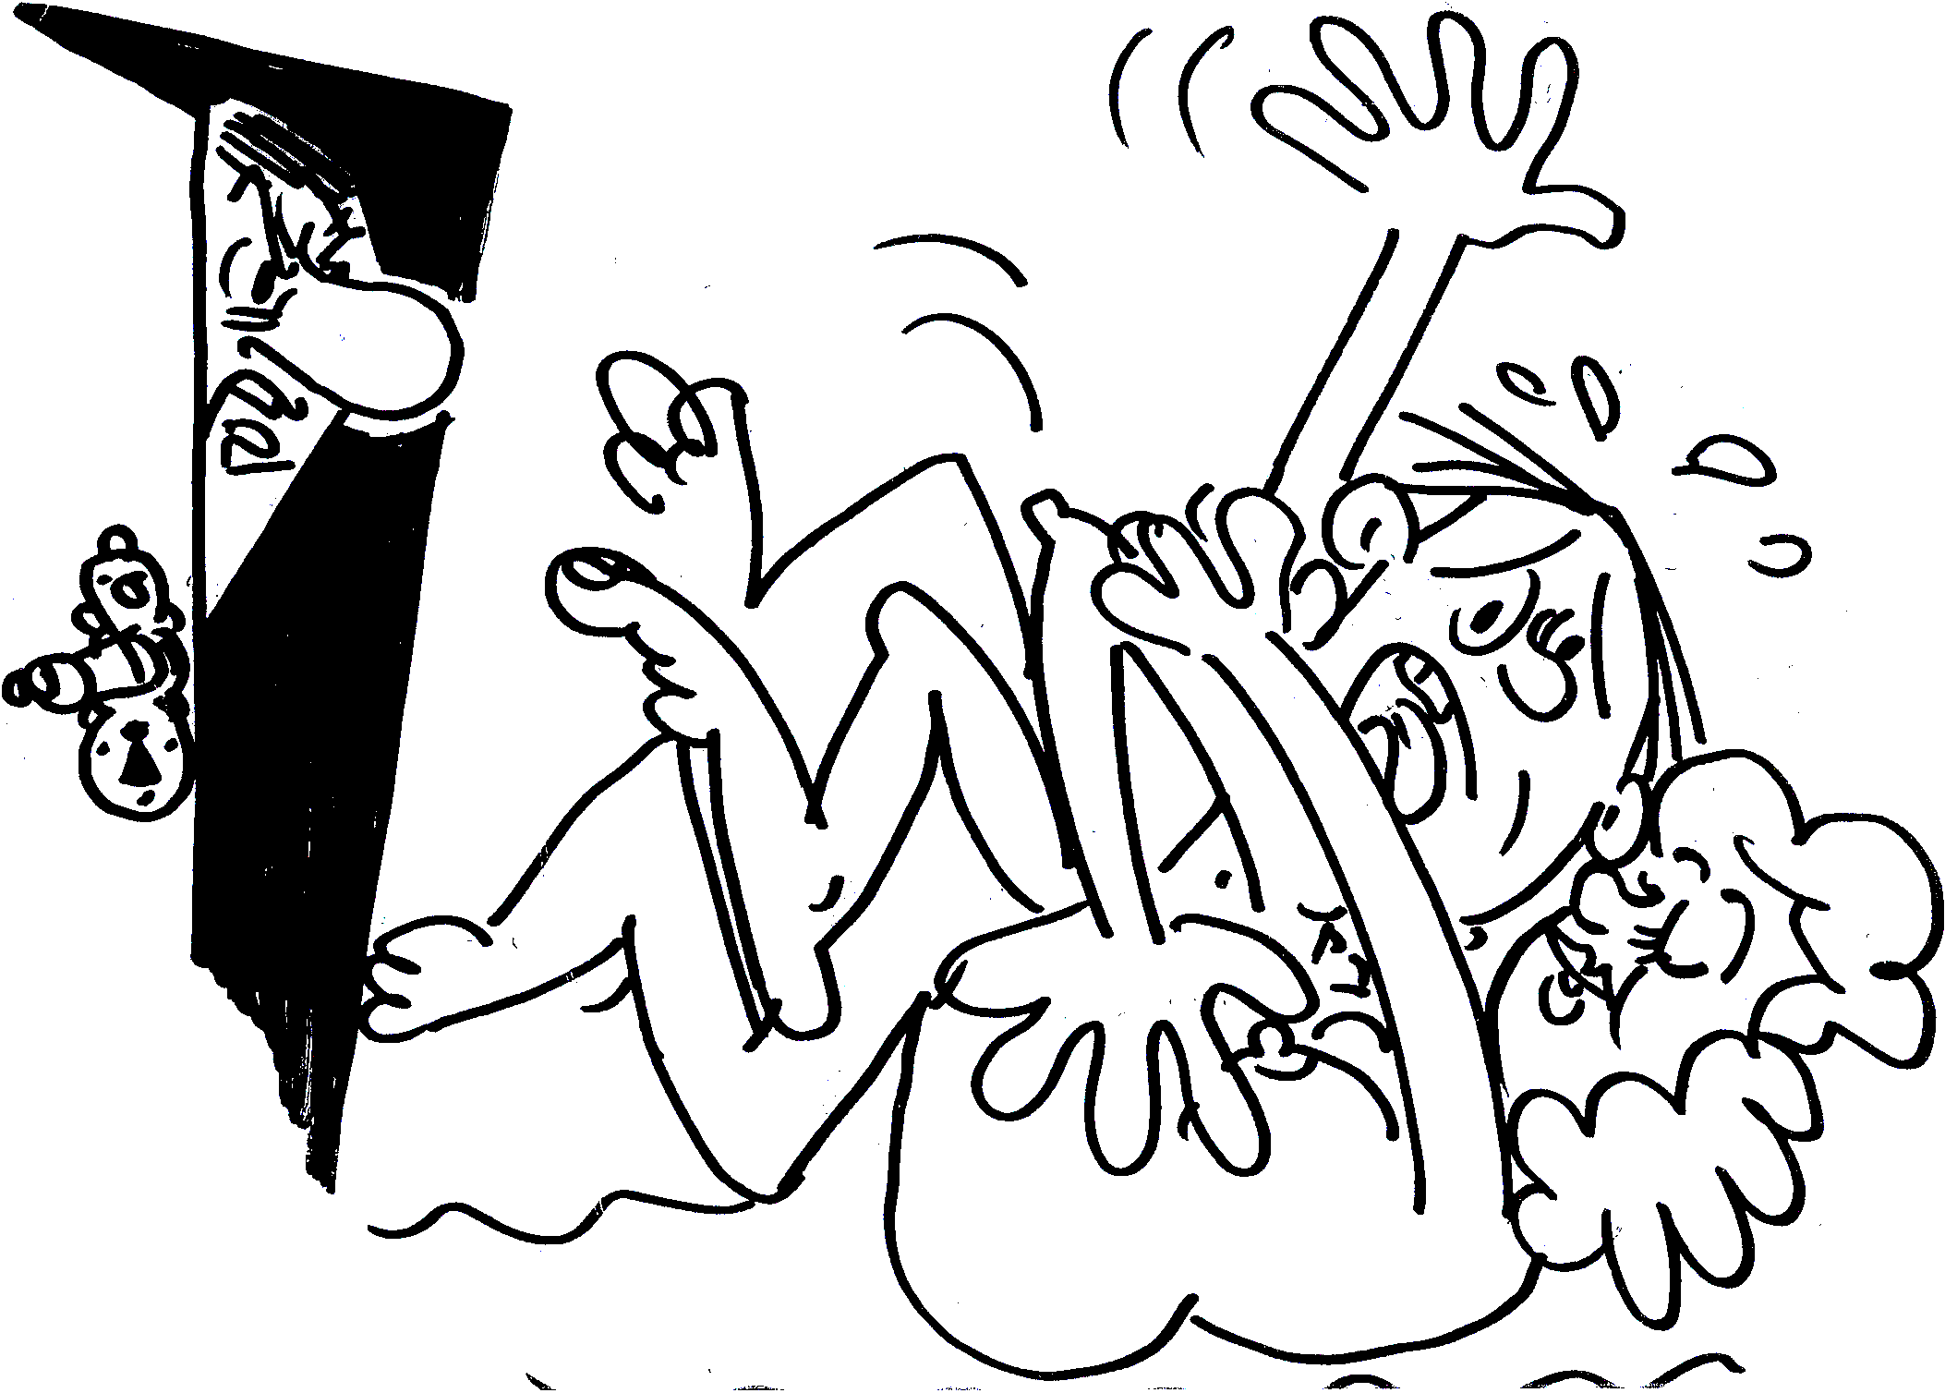
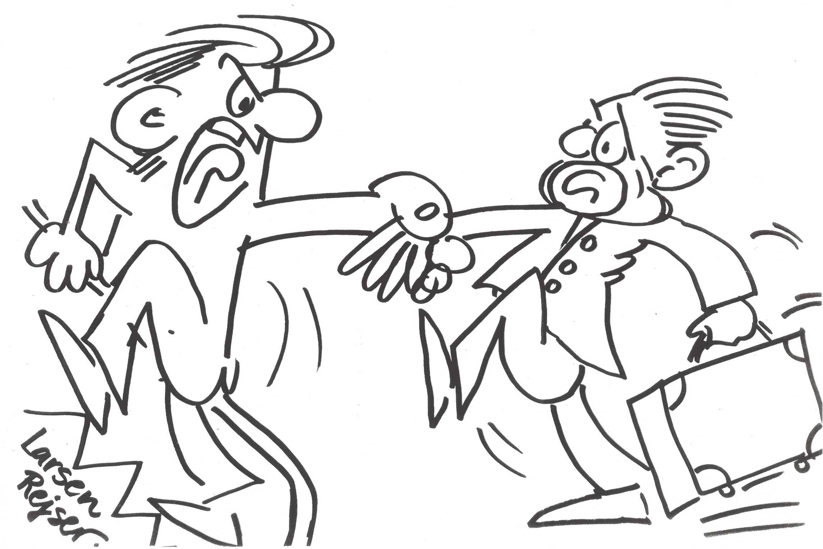
Selvdetemination – I decide
Money
Sparetime
Home
Eat, drink
Looks
Sex, relationsships
Hygiene
Support
Doctor, dentist
Notes:
Here is a excample of illustrating the concept of selfdetermination

Slide 19


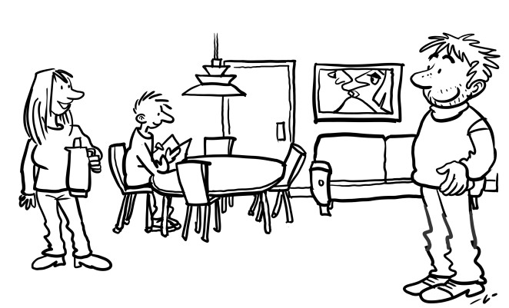
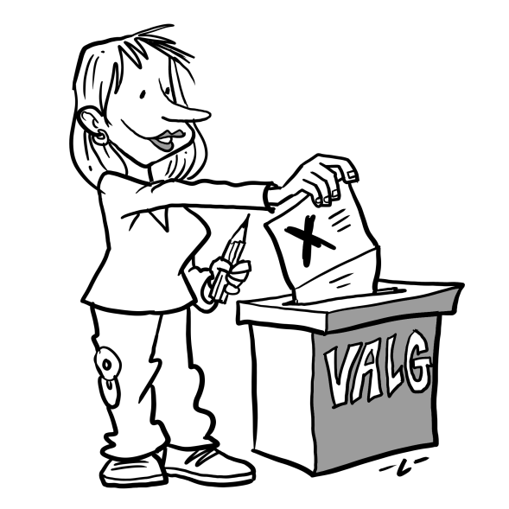
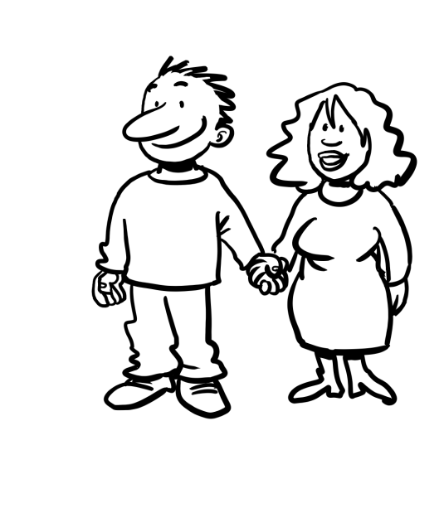
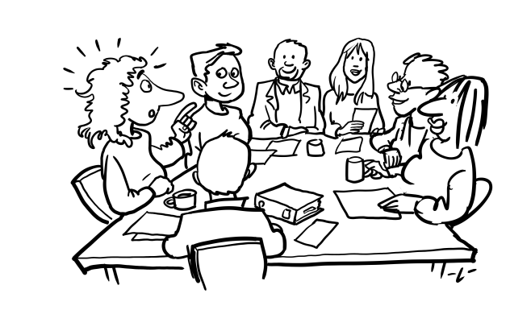
Medbestemmelse –
I decide with others
In common rooms
Elections
In userboards and other boards
Together with partner, friends

Slide 20


I have influence - but others decide
In big
gatherings
In meating with socialworker
In foreninger

Slide 21
Different ways and models to work with partipation
common discussion What topics / areas are suitable for the user? Red: Areas unsuitable for user Yellow: Areas maybe suitable for user Green: Areas suitable for user

Slide 22
Key Points in user participation
Individual rights. Personal rights and the possibility of deciding for oneself.
Active citizenship. Communication and making decisions in collaboration with others.
Part of society. Communities within society and inclusion in the work place, education, leisure and cultural life.
Democracy and having influence. The democratic way of governing on a national as well a local level, and the opportunity of having influence.

